Slide 1
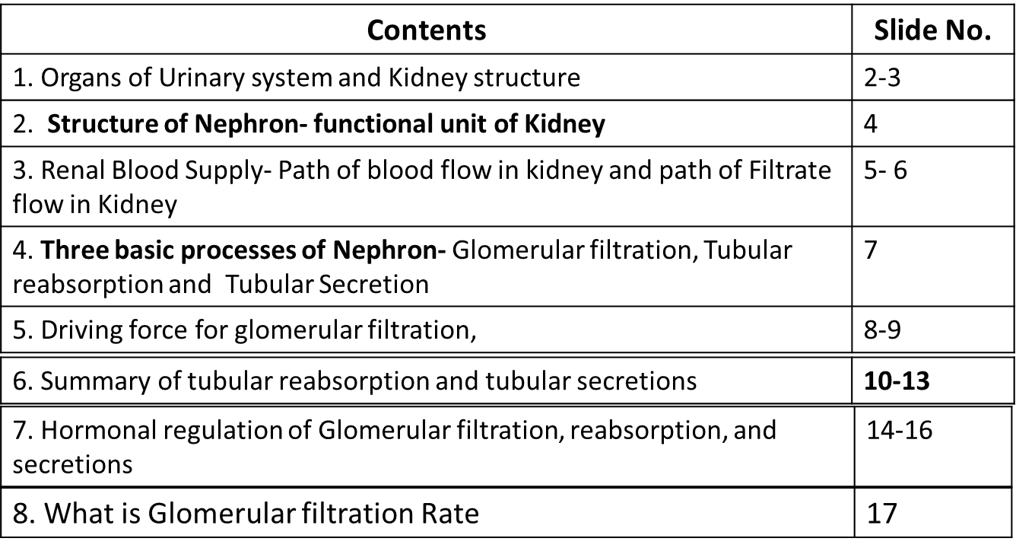


Unit IV- Human physiology Excretory System

Slide 2
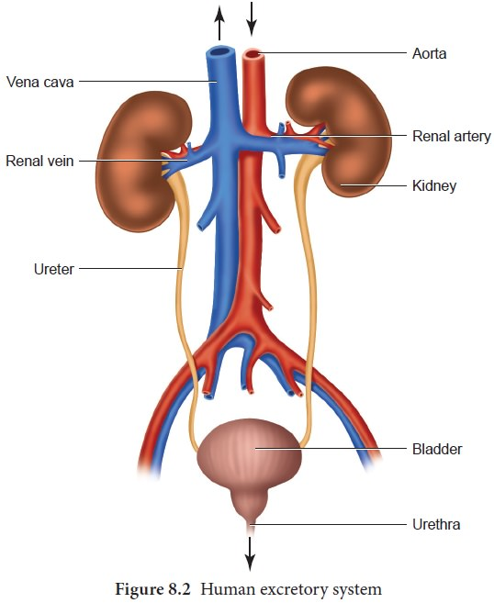
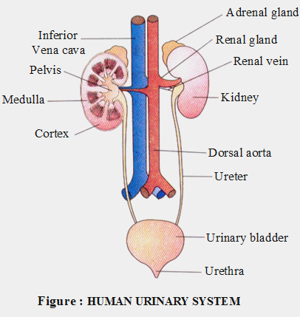
Organs of Human Urinary System- kidneys, Ureters, Urethera, Urinary bladder
Renal….. Related to Kidney

Slide 3
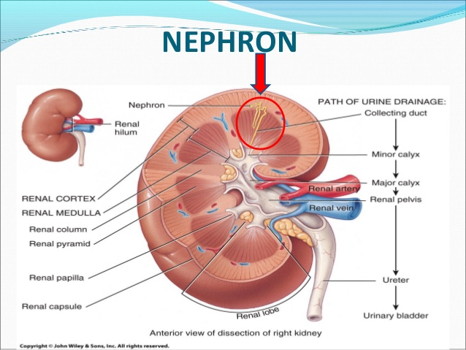
Kidney Anatomy

Slide 4
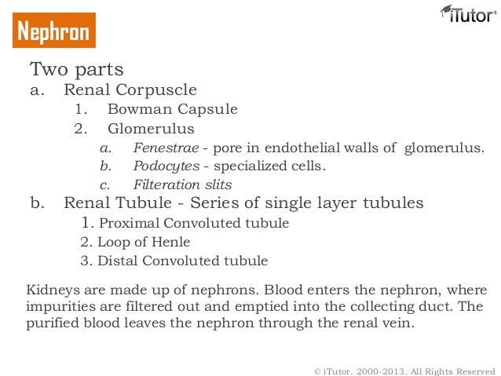
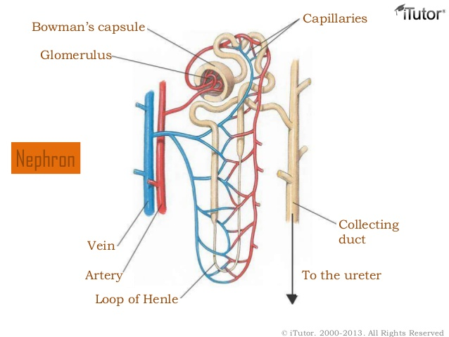
Nephrons are Functional unit of Kidney
Nephrons has two parts:
a) Renal corpuscle:
Glomerulus: tuft of capillaries. Afferent arteriole and efferent arteriole (of Renal artery) enters the glomerulus and forms tuft of capillaries.
Bowman’s capsule: a double-walled epithelial cup that surrounds the glomerular capillaries.
b) Renal tubule:
Proximal convoluted tubule (PCT)
Loop of Henle (descending and ascending loop)
Distal convoluted tubule (DCT)
Collecting duct

Slide 5
Renal blood supply
About 20-25 percent of the resting cardiac output 1200 hl of blood per minute flows into the kidneys through the right and left renal arteries.
Right and left renal arteries supplying oxygenated blood to both kidneys, divides to form afferent arteriole and efferent arteriole. Afferent arteriole divides to form tangled capillary network called glomerulus. The capillaries of glomerulus reunite to form efferent arteriole. Efferent arterioles divides to form peritubular capillaries (surrounding the renal tubules) and finally joins the renal vein.
Path of blood flow in Kidney
Renal Artery
Afferent arterioles
Glomerular capillaries
Efferent arterioles
Peritubular capillaries
Renal vein

Slide 6
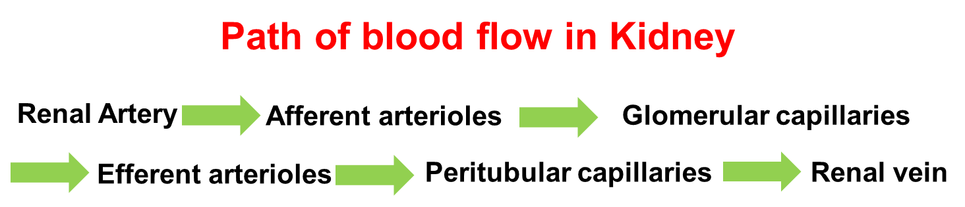
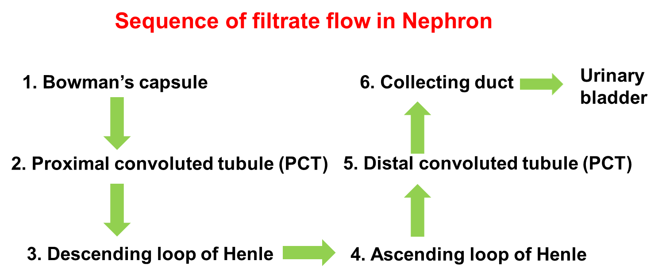
PCT, Henle’s loop, DCT and collecting duct are Parts of Renal Tubules

Slide 7
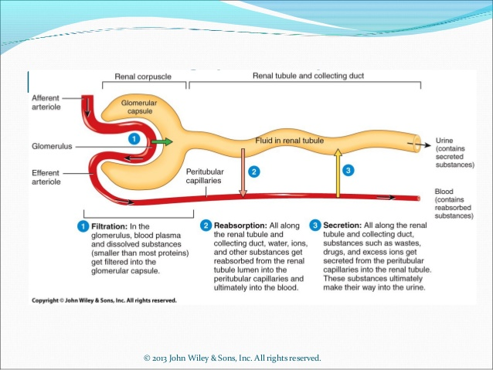
Three basic processes of Nephron
1) Glomerular filtration; 2) Tubular reabsorption; 3) Tubular secretion

Slide 8
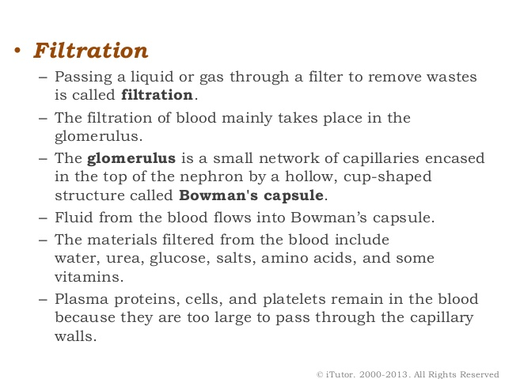
Filtration in Renal corpuscle -Glomerular Filtration: What is filtered from the blood in Glomerulus and enters the Bowman’s capsule?
(From afferent arteriole to Bowman’ s capsule…filtered fluid)
99% water enters the bowman’s capsule
RBC’s
(filtered blood in efferent arteriole)

Slide 9
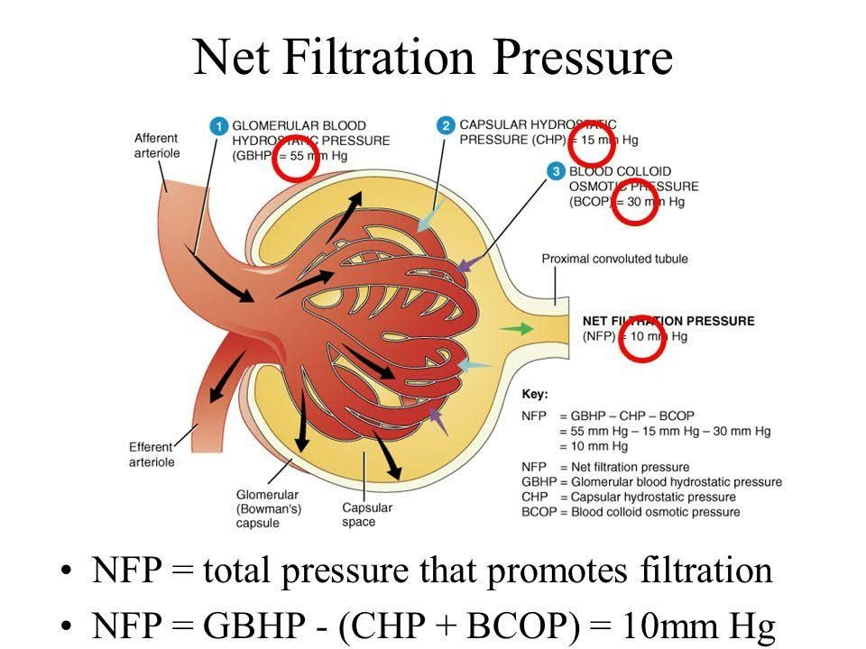
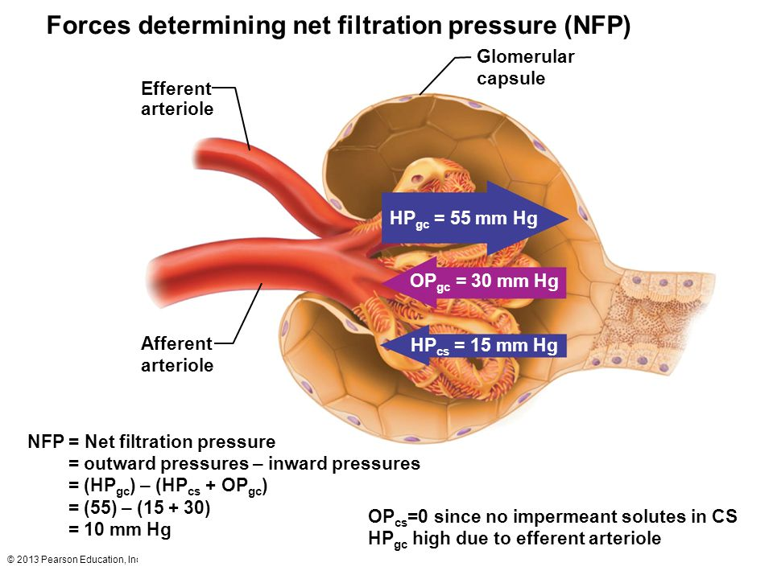
Driving force for the glomerular filtration
Net filtration pressure (NFP) is the total pressure that promotes filtration and is determined as:
NFP = HP gc- (HPcs + OPgc)= 55- (30+15)= 10 mmHg
Net filtration pressure forces a large volume of fluid into the capsular space, about 150 litres daily in females and 180 litres daily in males.
HP= Hydrostatic pressure
gc = glomerular capillaries
oc = osmotic pressures

Slide 10
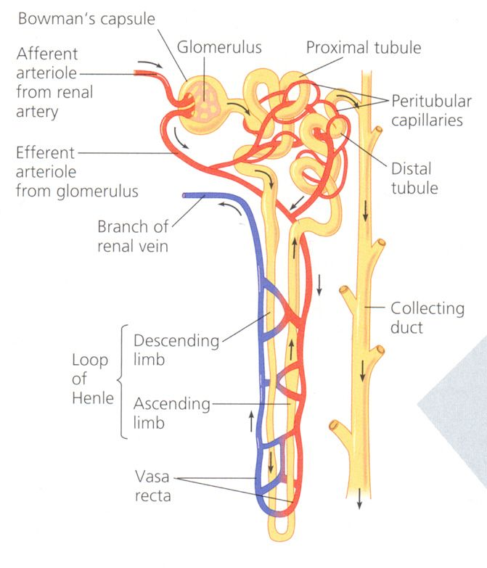
After Glomerular filtration, next processes in nephrons are
2. Tubular reabsorption
3. Tubular secretion
Tubular Reabsorption and Tubular secretion process occurs together and involves tubules of nephron and peritubular capillaries.
Reabsorption means……..nephron tubules to peritubular capillaries.
Secretion means…….. Peritubular capillaries to Nephron tubules
Nephron tubules that is extended from bowman’s capsule are as follows :
Proximal convoluted tubule
Descending Henle’s loop,
ascending Henle’s loop
Distal convoluted tubule

Slide 11
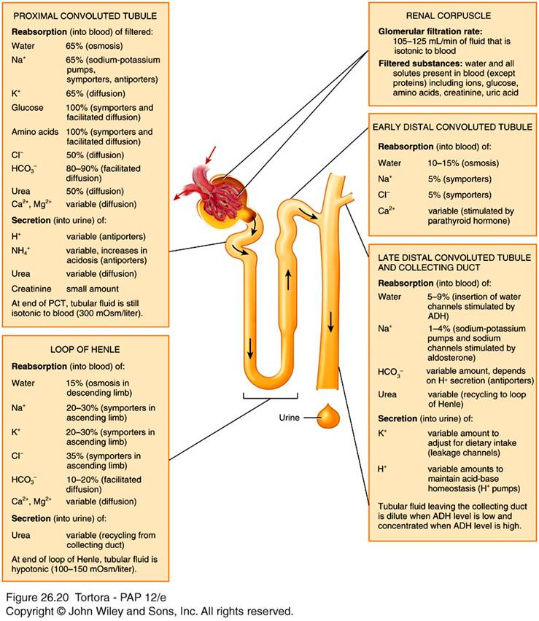
Summary of filtration, reabsorption and secretion in the nephron and collecting duct

Slide 12
2. Tubular reabsorption
It is the process by which most of the filtered water, and many of the filtered solutes to the blood.
Proximal convoluted tubule (PCT) cells make the largest contribution, reabsorbing 65 percent of the filtered water and large quantities of various ions such as Na⁺, K⁺, Cl⁻, HCO₃⁻, Ca²⁺, and Mg²⁺. Reabsorption of solutes into peritubular capillaries decreases the solute concentration of the filtrate and as a result water moves by osmosis into peritubular capillaries. To maintain the homeostatic balances of water and selected ions, the cells located distal to the PCT causes further reabsorption.
Henle’ loop: The descending loop of Henle allows reabsorption of water and almost impermeable to electrolytes. Aquaporins allow water to reabsorb in descending loop. The ascending loop of Henle is allows reabsorption of electrolytes and impermeable to water.
Distal convoluted tubule. Water, Na , Cl, Ca reabsorption, secretion of potassium and H+

Slide 13
3. Tubular secretion
Tubular secretion means transfer of materials from the blood through tubule cells and into tubular fluid/filtrate.
Secreted substances include hydrogen ions (H⁺), K^{+,} ammonia (NH₃), urea, creatinine (a waste from creatinine in muscle cells) and certain drugs such as penicillin. Tubular secretion helps eliminate these substances from the body.
Tubular secretion helps control blood pH. A normal blood pH of 7.35 to 7.45 is maintained even though more acid producing food is consumed. To eliminate acids, the cells of the renal tubules secrete H+ into the tubular fluid, which helps maintain the pH of blood in normal range. Due to H+ secretion, urine is typically acidic.

Slide 14
Hormonal regulation of glomerular filtration rate
Hormone regulation | Major stimulus | Mechanism and site of action | Effect on GFR
Angiotensin II | Decreased blood volume or blood pressure stimulates production of angiotensin II | Constriction of afferent and efferent arterioles | Decrease
Atrial natriuretic peptide (ANP) | Stretching of atria of heart stimulates secretion of ANP | Relaxation of mesangial cells in glomerulus increases capillary surface area available for filtration. | increase

Slide 15
Hormonal regulation control of tubular reabsorption and secretion by renin-angiotensin-aldosterone-pathway
Hormones | Sites of secretion | Functions
Angiotensin II | Liver. | Act in proximal convoluted tubule, increases reabsorption of Na+ and cl- other solutes and water
Renin | Kidney medulla | Renin converts angiotensinogen to angiotensin I, angiotensin I is converted to angiotensin II by the action of Angiotensin converting enzyme.
Aldosterone | Adrenal gland (kidney) | Act in distal convoluted tubule and collecting duct, increases reabsorption of Na+, Cl-, and water, and causes secretion of K+. Aldosterone-stimulated secretion of k+ is the major regulator of blood K+ level.
Antidiuretic hormone | Pituitary gland in brain attached to hypothalamus | Acts on distal convoluted tubule and collecting duct, increases water permeability by causing insertion of proteins that function as water channels into their plasma membrane
Atrial natriuretic peptide (ANP) | Atria of heart | Inhibits reabsorption of sodium and water in proximal tubule and collecting duct. Increases glomerular filtration rate (GFR)

Slide 16
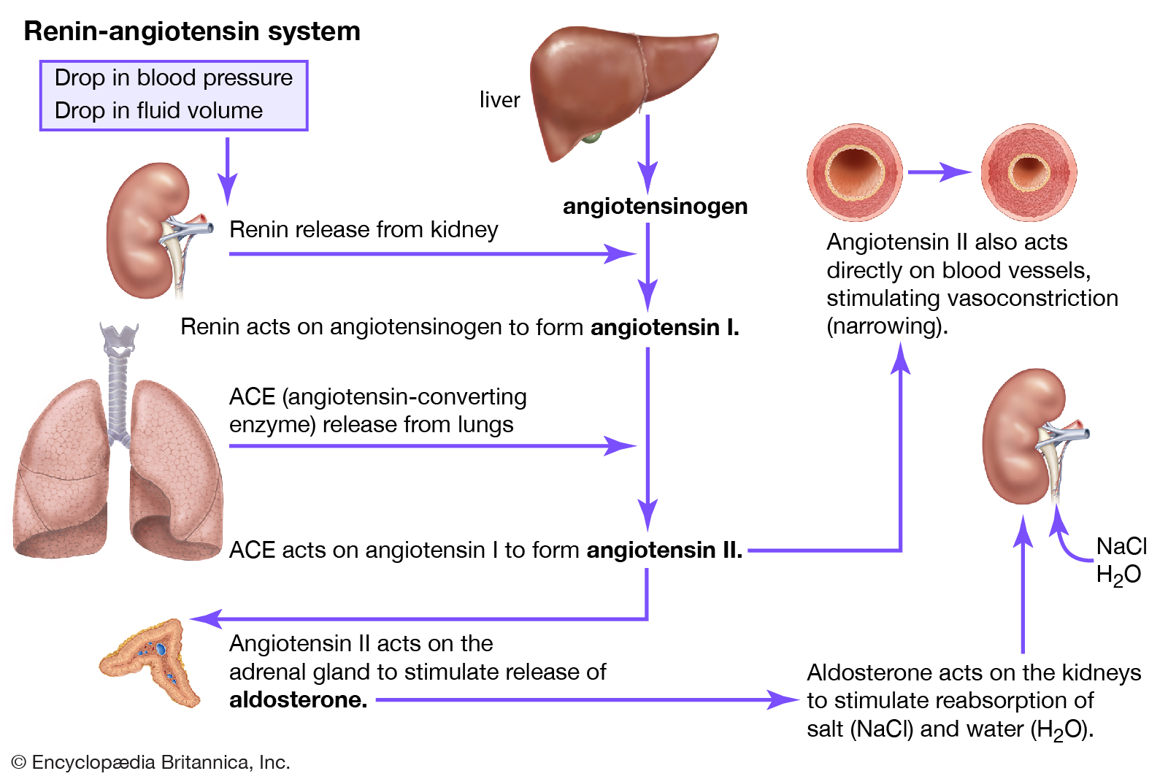

Slide 17
What is Glomerular Filtration rate?
Glomerular filtration rate (GFR) represents the flow of plasma from the glomerulus into Bowman’s space over a specified period or volume of plasma filtered per unit time and is approximately 120-125 ml per minute. The kidneys receive 20% to 25% of the cardiac output (about 1.0 to 1.1 litres per minute). The amount of filtrate that forms in both kidneys every minute is called the glomerular filtration rate (GFR). GFR is approximately 120-125 ml (0.12 to 0.125 litre) per min (180 L per day) . Average urine output, on the other hand, averages only about 1.5 L daily. The reabsorption of 178.5 L requires a sophisticated tubular network
In adults, the GFR is about 105 mL/min in females and 125 mL/min in males. It is very important for the kidneys to maintain a constant GFR. If the GFR is too high, needed substances pass so quickly through the renal tubules that they are unable to be reabsorbed and pass out of the body as part of urine. On the other hand, if the GFR is too low, nearly all the filtrate is reabsorbed, and waste products are not adequately excreted.

Slide 18
Kidney functions
Kidney functions | How?
Regulation of ion levels in the blood | Through process of reabsorption in renal tubules of nephron, Kidneys help regulate the blood levels of several ions, most importantly Sodium ions, potassium ions, calcium ions, chloride ions, and phosphate ions
2) Regulation of blood volume and blood pressure | The kidneys adjust the volume of blood in the body by returning water to the blood or eliminating it in the urine. They help regulate blood pressure by secreting the enzyme renin, which activates the renin-angiotensin-aldosterone pathway by adjusting blood flow into and out of kidneys and by adjusting blood volume.
3) Regulation of blood pH | The kidneys regulate the concentration of H⁺ in the blood by excreting a variable amount of H⁺ in the urine. They also conserve blood bicarbonate ions (HCO3⁻), an important buffer of H⁺. Both activities help regulate blood pH

Slide 19
4) Endocrine functions of Kidneys……Production of Hormones | Final activation of vitamin D to the active hormone calcitriol takes place in the kidneys... Calcitriol stimulates the small intestine for protein synthesis allowing absorption of Ca²⁺ and phosphates. This ensures the availability of Ca²⁺ and phosphate for bone growth. Calcitriol simultaneously activates osteoblasts to synthesize collagen.ilability Erythropoietin is a glycoprotein containing 165 amino acids. Its receptors are present on the membranes of red blood cell precursors. Binding of the hormone reduces apoptosis of these cells – multiple cells survive and can therefore complete their development into mature erythrocytes. Renin. In the case of insufficient blood flow to the kidneys (e.g., decrease in blood volume) cells of the renal juxtaglomerular apparatus begin the synthesis of protein renin. Renin is an enzyme, which catalyzes the conversion of plasmatic angiotensinogen to angiotensin I. Angiotensin I is then converted by angiotensin converting enzyme to angiotensin II, which stimulates aldosterone synthesis and causes vasoconstriction⁺
5) Excretion of wastes | Ammonia and urea from the breakdown of amino acids, bilirubin form the breakdown of haemoglobin; creatinine from the breakdown of creatine phosphate in muscle fibres, and uric acid from the breakdown of nucleic acids. Other wastes excreted in urine are foreign substances from the diet, such as drugs and environmental toxins

